Slide 1


Tree Planting
Notes:
Holding slide

Slide 2



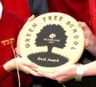

How to ‘sow’ tree planting into your curriculum
Project Planning Phase
Map the school grounds – KS2 Geog: use fieldwork to observe, measure, record and present the human and physical features in the local area using a range of methods including sketch maps, plans and graphs and digital technologies.
Tree Survey – Science Y3 : Id and describe functions of different parts of flowering plants :roots, stem/trunk, leaves and flowers. Y4 : recognise that living things can be grouped in a variety of ways : explore and use classification keys Y6 : describe how living things are classified into groups according to observable characteristics: give reasons for classifying plants based on specific characteristics.
What would grow well /where – Science Y3 – recognise that soils are made from rocks and organic matter ( soil type- dirty hands test)
Write persuasive letters /prep an assembly/PPT- KS2 English – pupils should have opportunities to write for a range of real purposes, consider audience.
Notes:
Obviously time needs to be set aside in the timetable for the practicalities of tree planting and the more involved your pupils are with every bit of the process the more successful./sustainable your planting project is likely to be –
Use it to tick boxes in your curriculum to save you finding time to squeeze it in ( add in not on!)
Project planning phase – use it as an action for your eco team / class /year group that feeds into your Green flag Eco Schools application, woodland Trust – ‘Green Tree’ award – Woodland Trust, Wilder Schools action, Young Tree champion Award ( tree council) / Climate Leaders Award
( new award launching now ( ish ) from the DfE ) put links to these in the ‘after pack’
Mapping – Geog @KS2- mention GIS – ‘team wilder’ map on SWT – national nature park map – DfE
Tree survey – what do we have already , what would be good to plant for increased bio diversity ( discuss native/non-native) – which trees will grow well on our site /have best wildlife benefits- link to getting to know local area / habitats – soil type- - Science non stst guidance says : pupils should study and raise questions about their local environment throughout the year. They should observe changes in a variety of living things – eg plants , animals in local env. Pupils should build on their learning ( Y4) by looking at classification system in more detail – use ‘tree id’ keys ( woodland trust , seek app , )

Slide 3
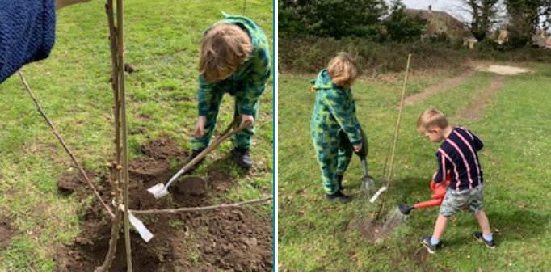
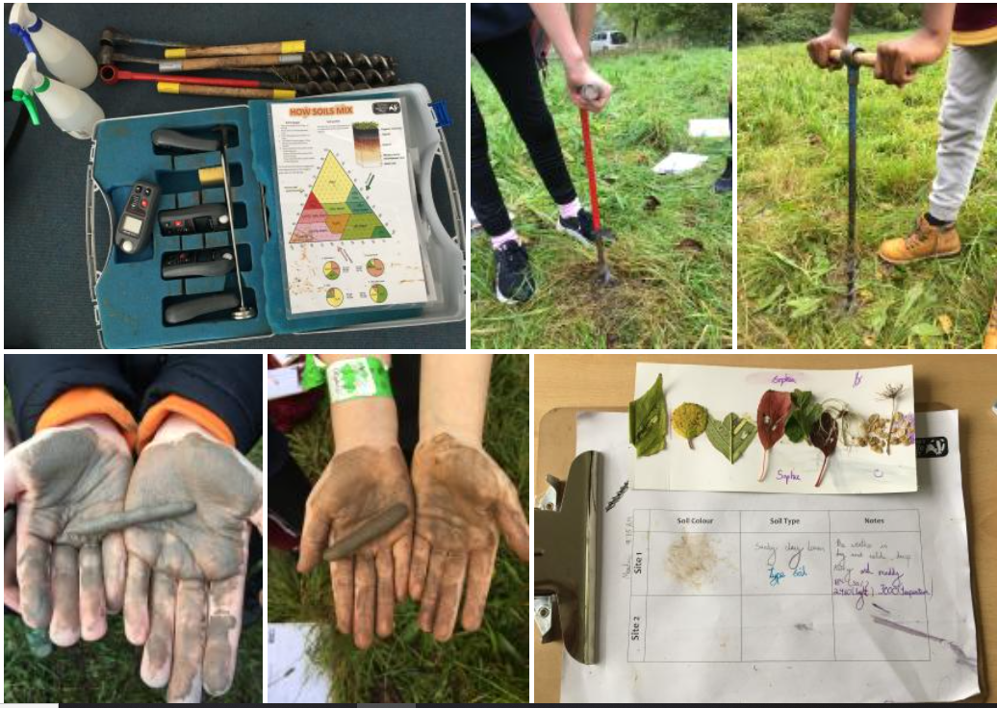
Practical Tree Planting
Measuring area ( converting units)
Planning planting ( hedges- pattern , logic)
Soil Testing ( dirty hands test- fieldwork )
Test site Conditions- temp, aspect, (data loggers)
Physical work- safe tool use
Investigate what trees need to grow and thrive

Slide 4
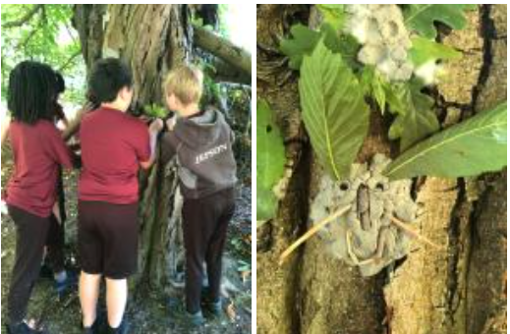
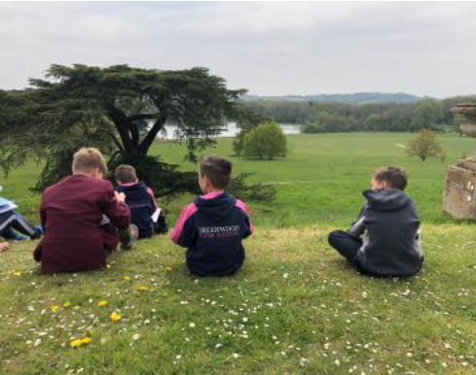
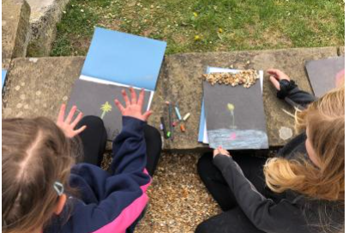
Established trees/hedge
Poster designs – explain and share
Writing reports on native trees- research/non chronological reports
Geometry/art- collecting seeds, drawing shapes
Investigate leaves- estimating and measuring in mm and cm/area – what is their function?
Art- creating sketchbooks/using natural materials
Creative writing/poetry context/inspiration
Wellbeing / nature connection/ sensory activities
Tree poetry
Non fiction writing – tree research
Maths – measure trees
Survey techniques – tree beating

Slide 5
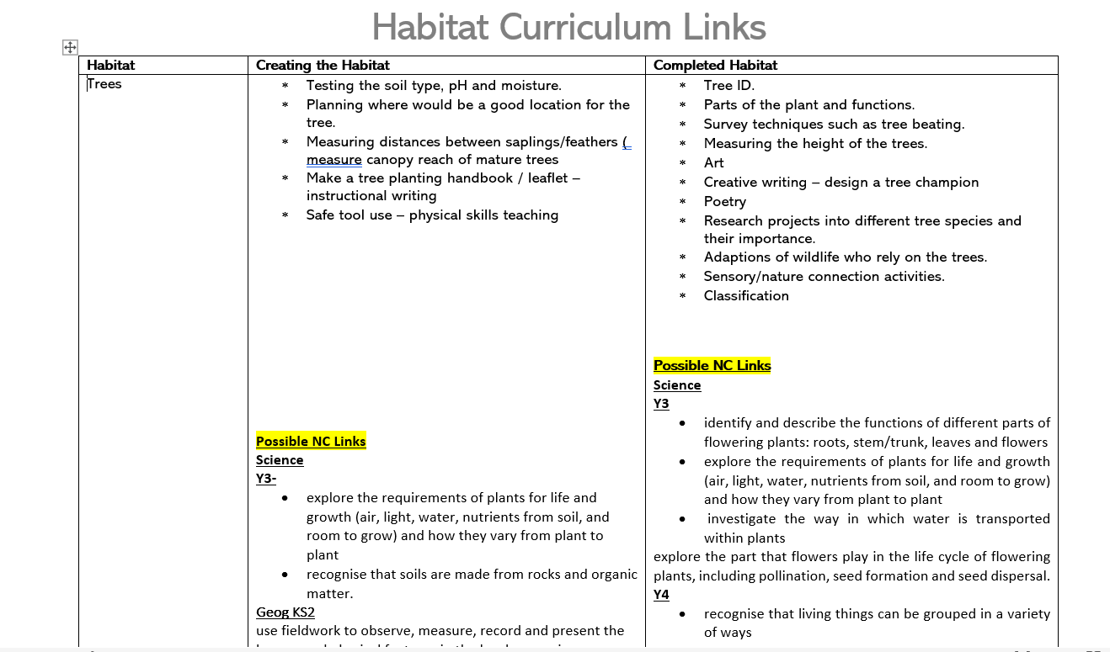
Notes:
We have created a document filled with activity/teaching ideas/ points and the possible links to NC areas – will share
Also consider Ofsted personal development goals- your tree planting may help prove you are: for eg
Developing : responsible , respectful, active citizens who are able to play their part and become actively involved in public life
Provide ample opps for pupils to be active during school day
Develop pupils who co op consistently well with others etc…

Slide 6
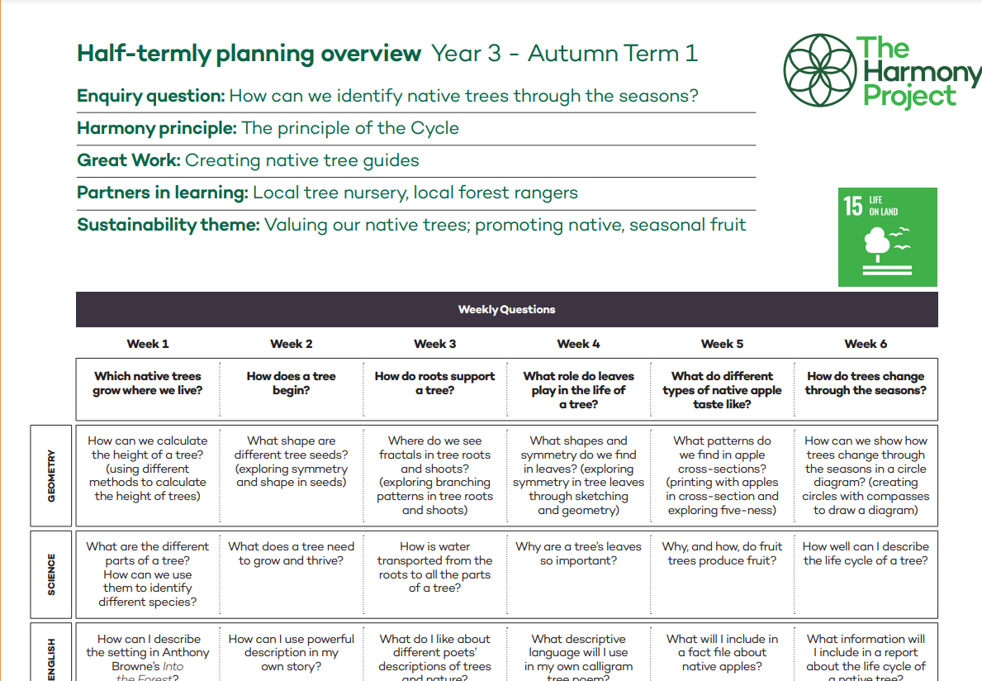
https://www.theharmonyproject.org.uk/
Notes:
The Harmony project - a charity founded by a Surrey HT has designed a curriculum based upon 6 principles of nature – interdependence, the cycle, diversity, adaptation, health and geometry
The curriculum is organised through enquiries of learning which give meaningful, real life contexts through which the children can apply their learning across all subjects . This Year 3 half termly overview is all about trees and might be a useful starting point toplan a series of lessons around your tree planting project
Available as a free downloadable pdf from www.harmonyproject.org.uk – will send out link and pop in chat

Slide 7




Ideas and resources
The Woodland Trust –Green Tree Schools Award https://www.woodlandtrust.org.uk/plant-trees/schools-and-communities/?utm_source=google&utm_medium=cpc&utm_campaign=community_tree_packs&utm_id=ctp&gclid=EAIaIQobChMI8fziz-qt-wIVVODtCh3zSQXBEAAYASAAEgL6GfD_BwE
The Harmony Project – curriculum planning https://www.theharmonyproject.org.uk/
Learning through Landscapes- lots of pdf lesson plans https://ltl.org.uk/
Surrey Wildlife Trust https://www.surreywildlifetrust.org/what-we-do/outdoor-learning
The Tree Council – orchards for schools , tree champions – https://treecouncil.org.uk/
tree seed gathering masterclass on you tube https://www.youtube.com/watch?v=BXJ0oJDjhXA
Notes:
https://www.youtube.com/watch?v=BXJ0oJDjhXA

Slide 8
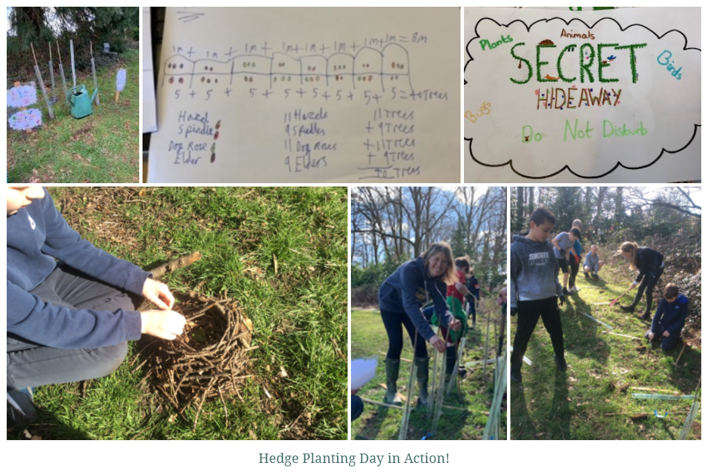
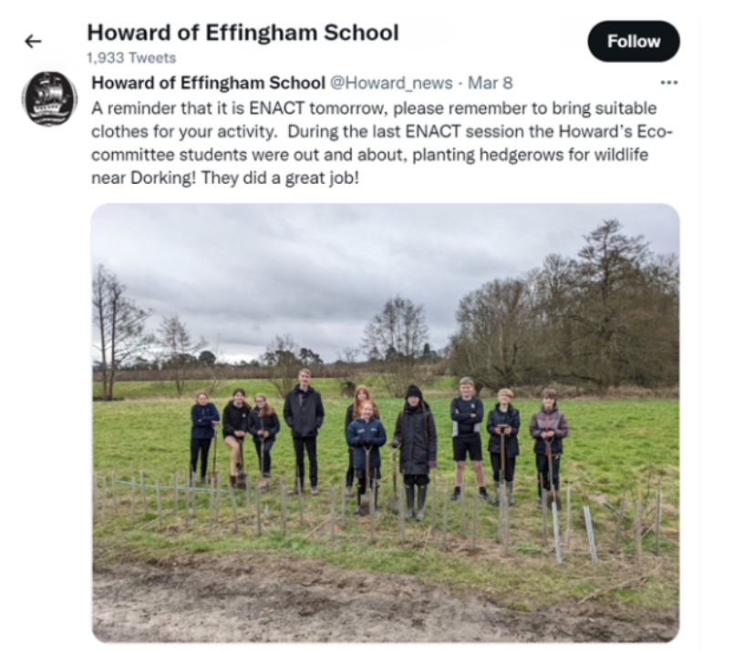
Tree Planting Success Stories
https://storymaps.arcgis.com/stories/2e43e018986646efa51d059f36fc3418
Notes:
Link to story maps – royal and a
Eastwick
Howard of Effingham
Croydon

