Slide 1
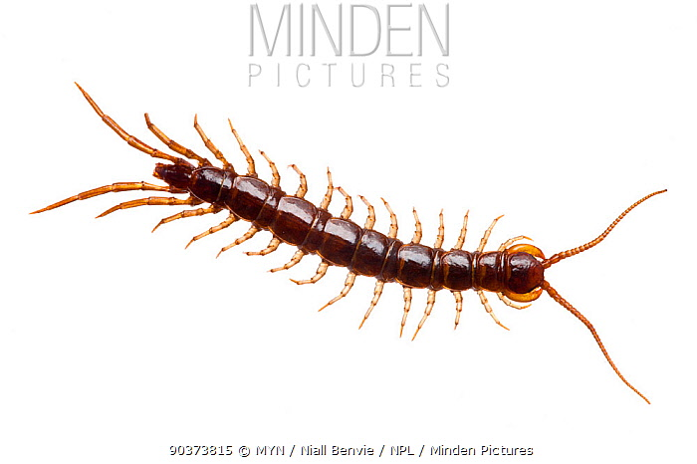

Slide 3
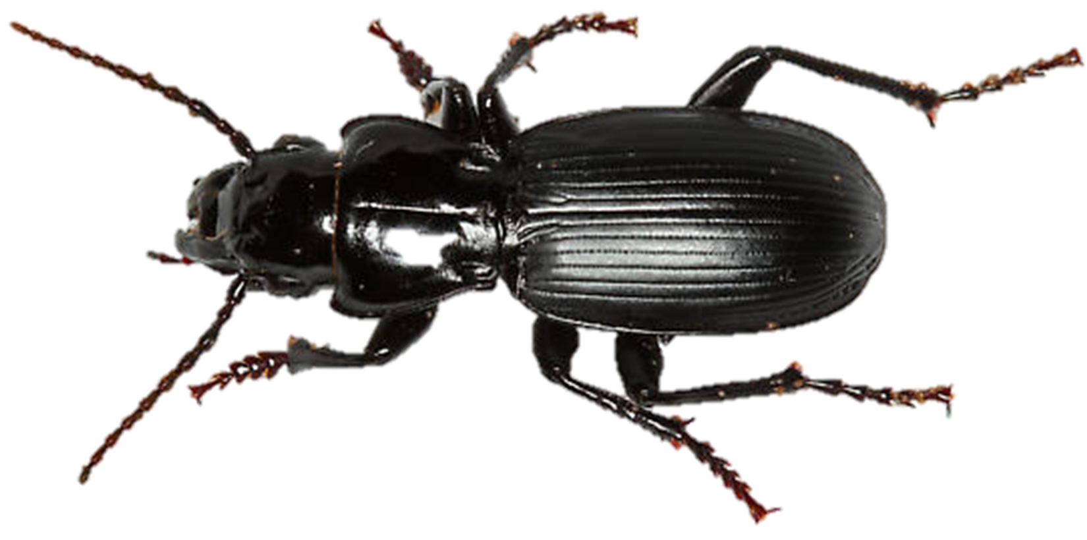

Slide 8
Life Cycle of ground beetle

